Slide 1
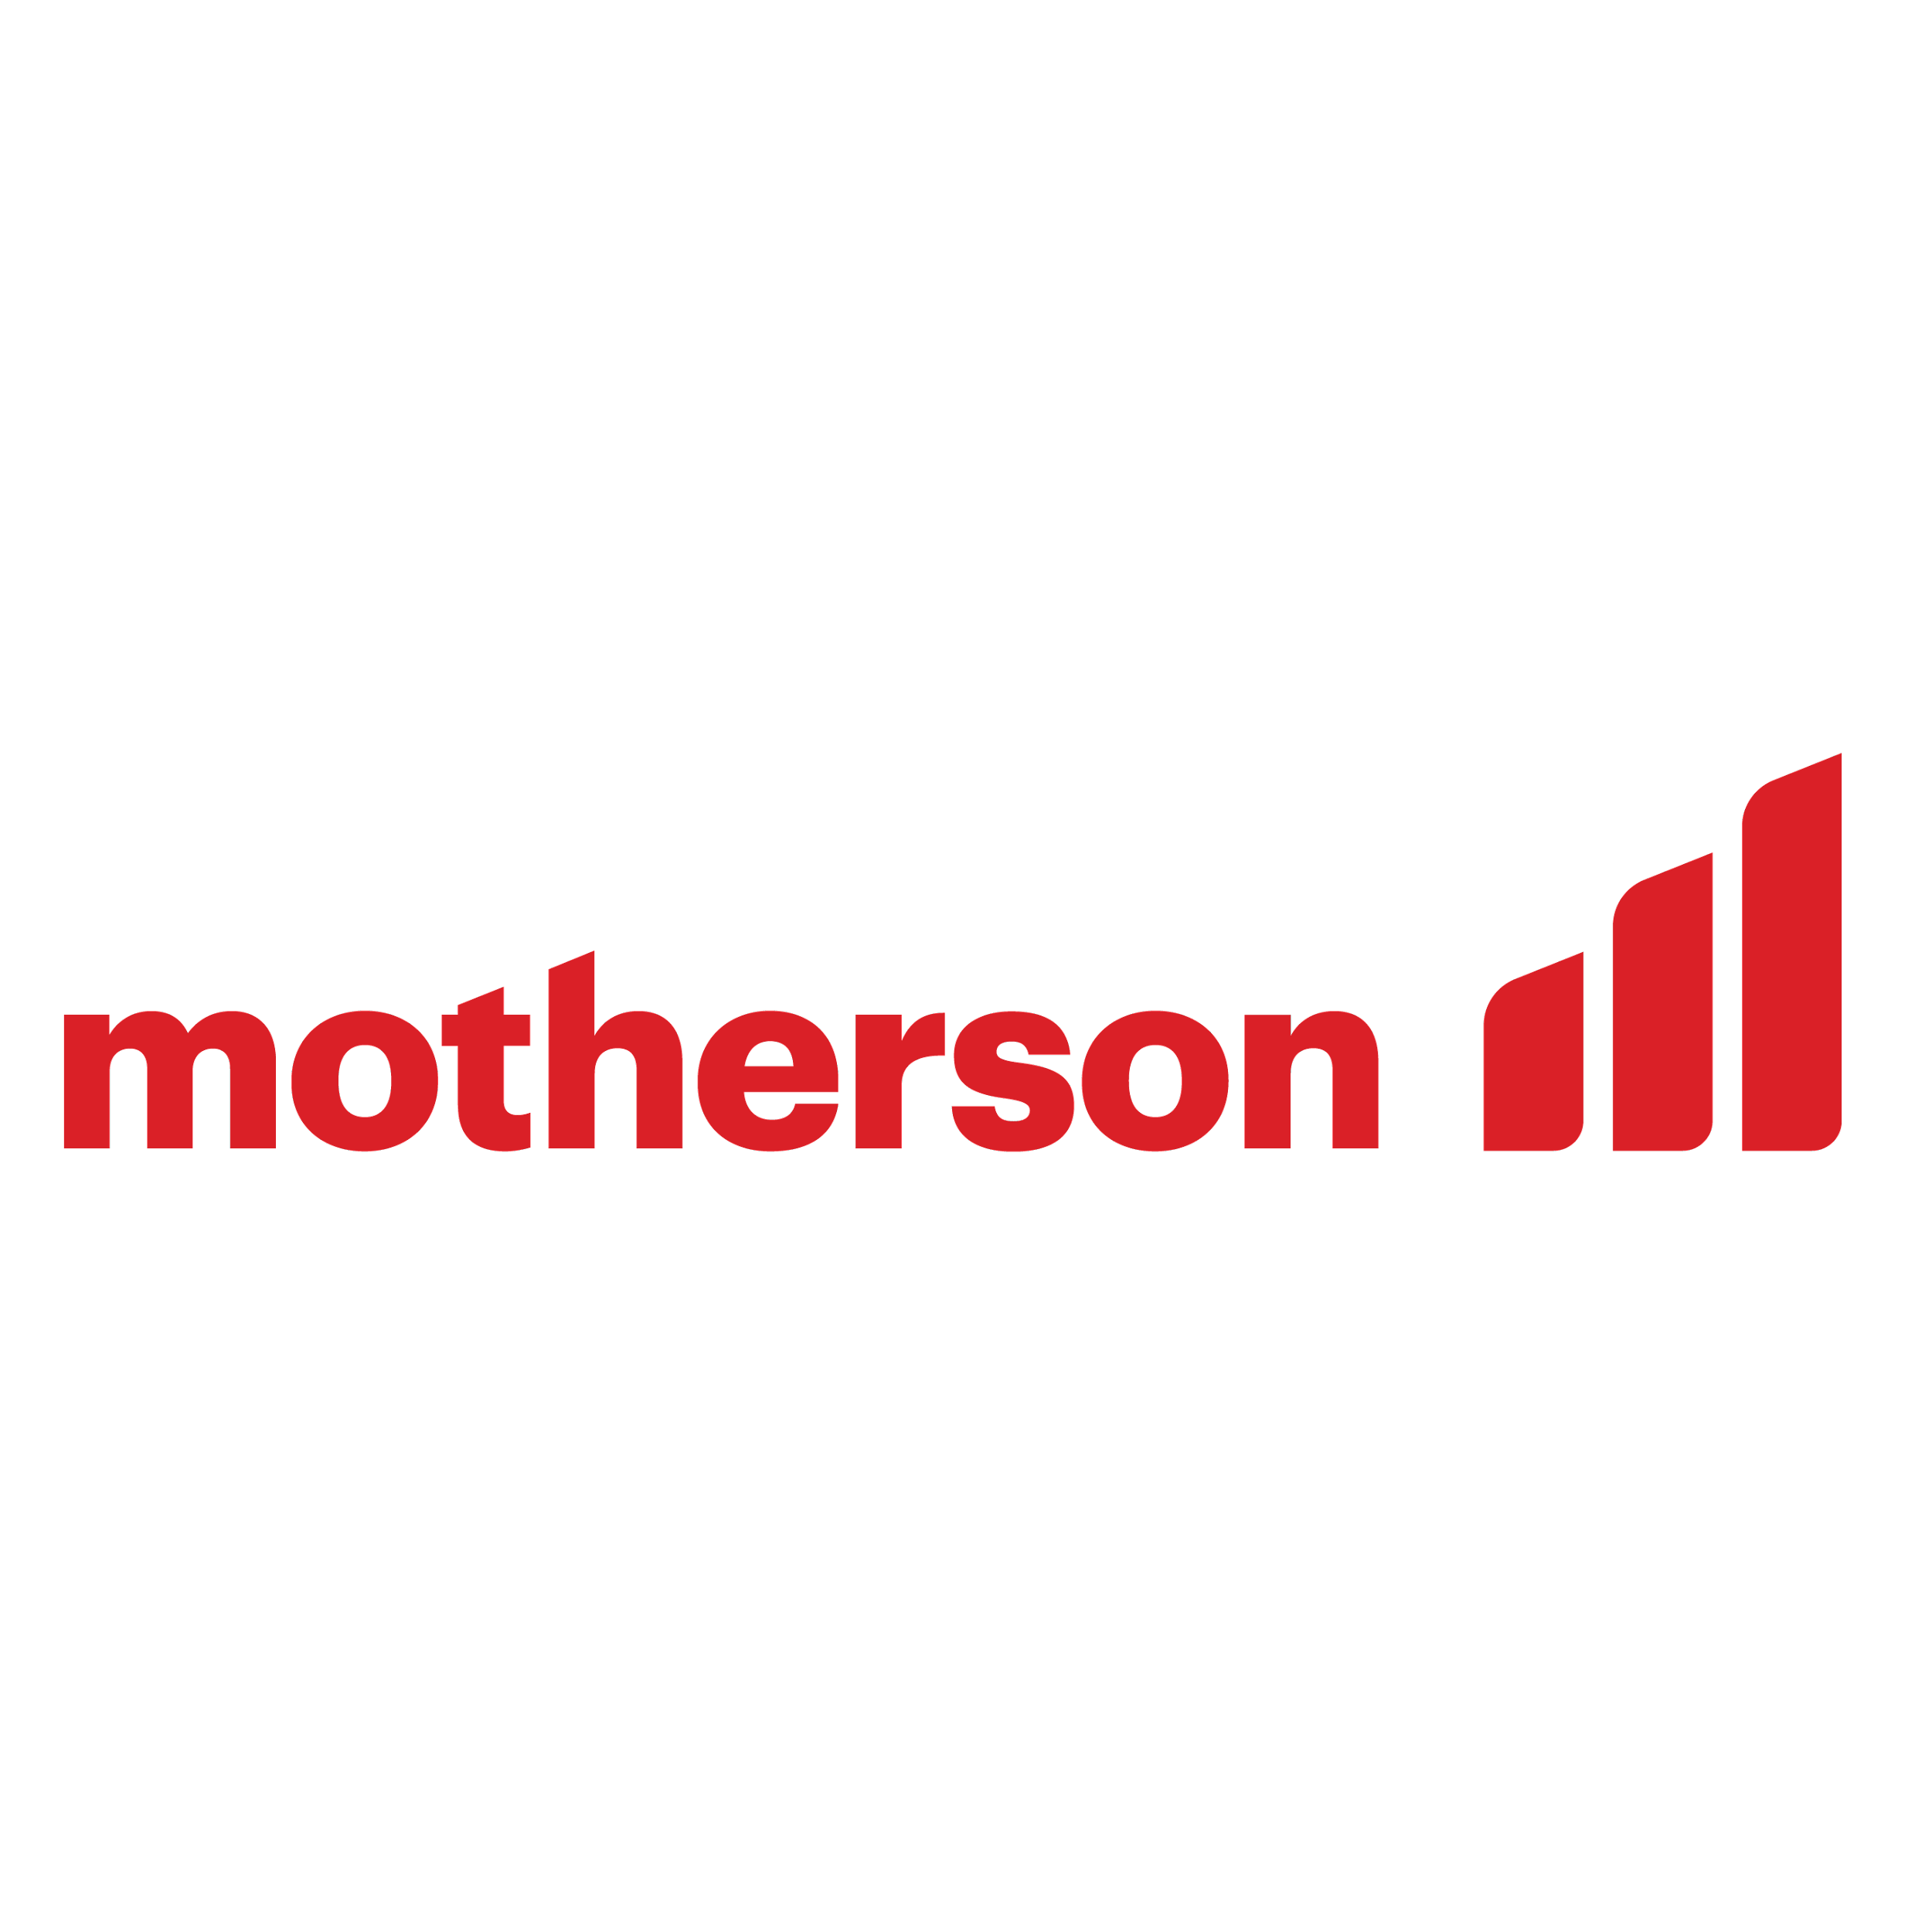
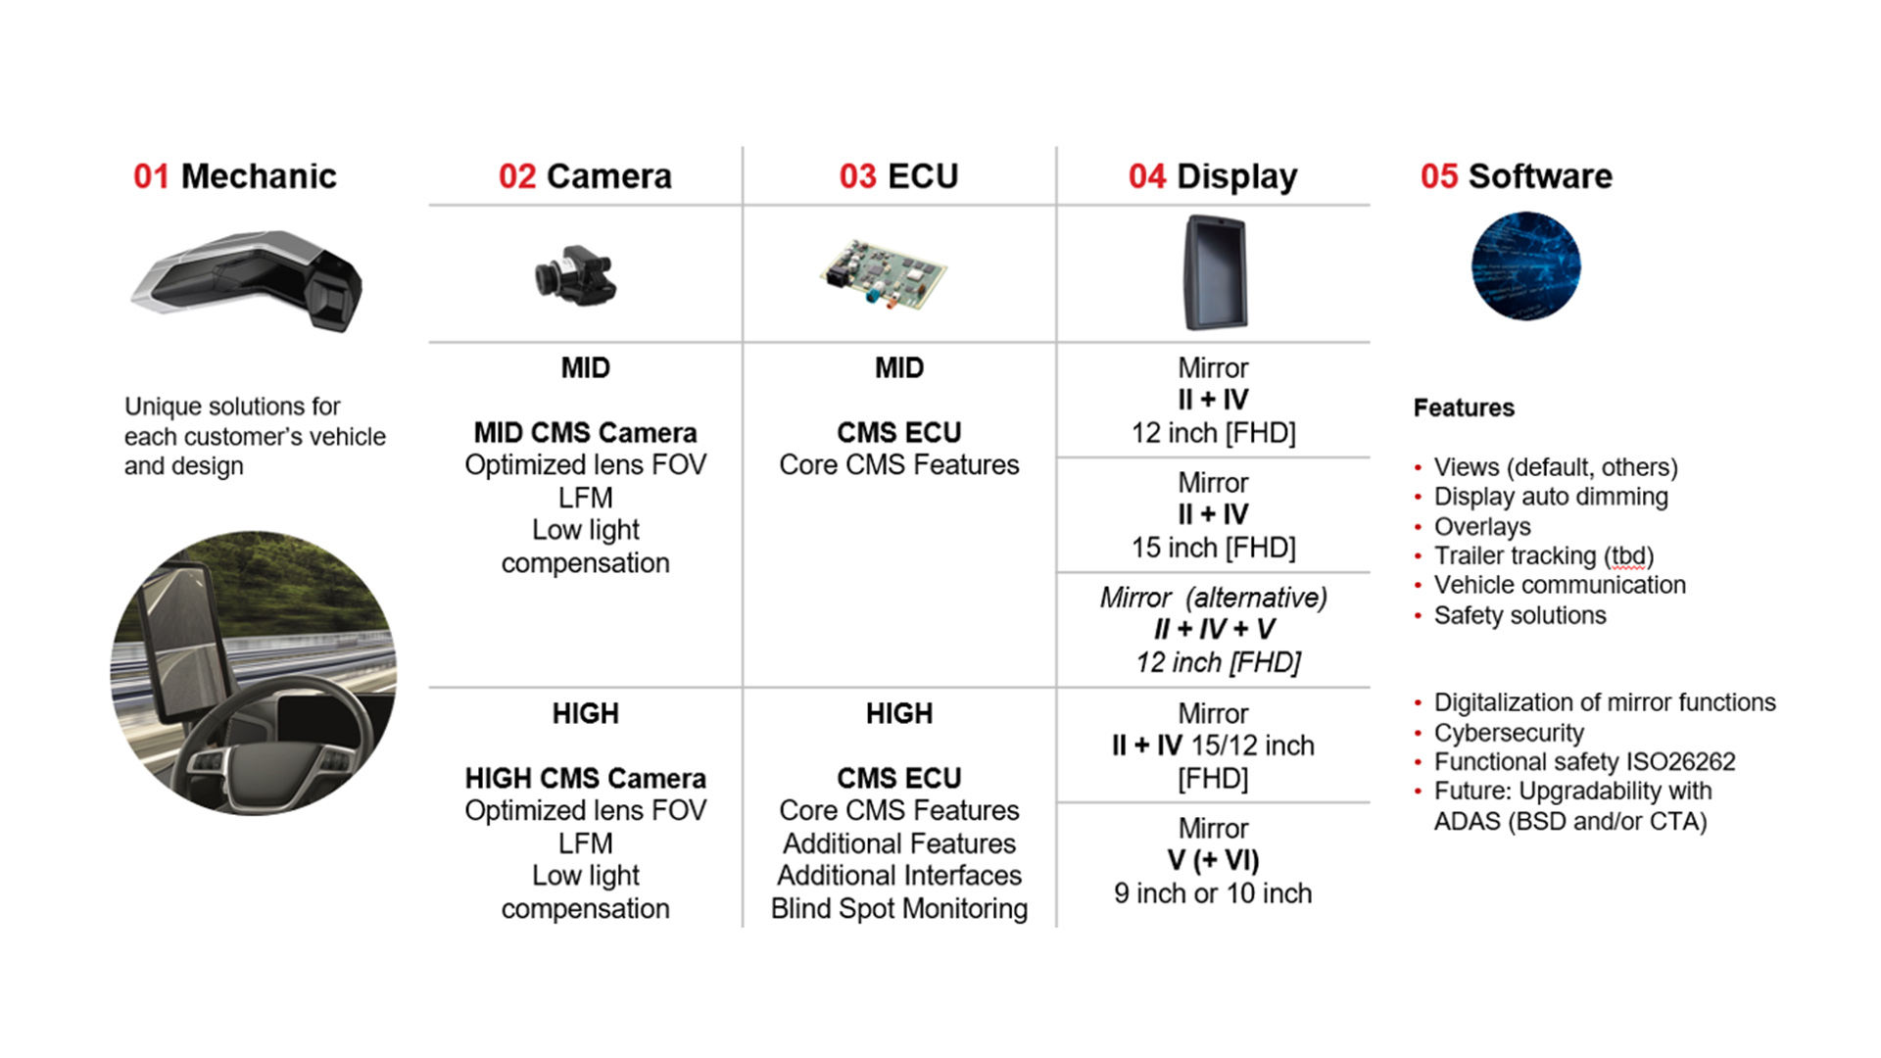
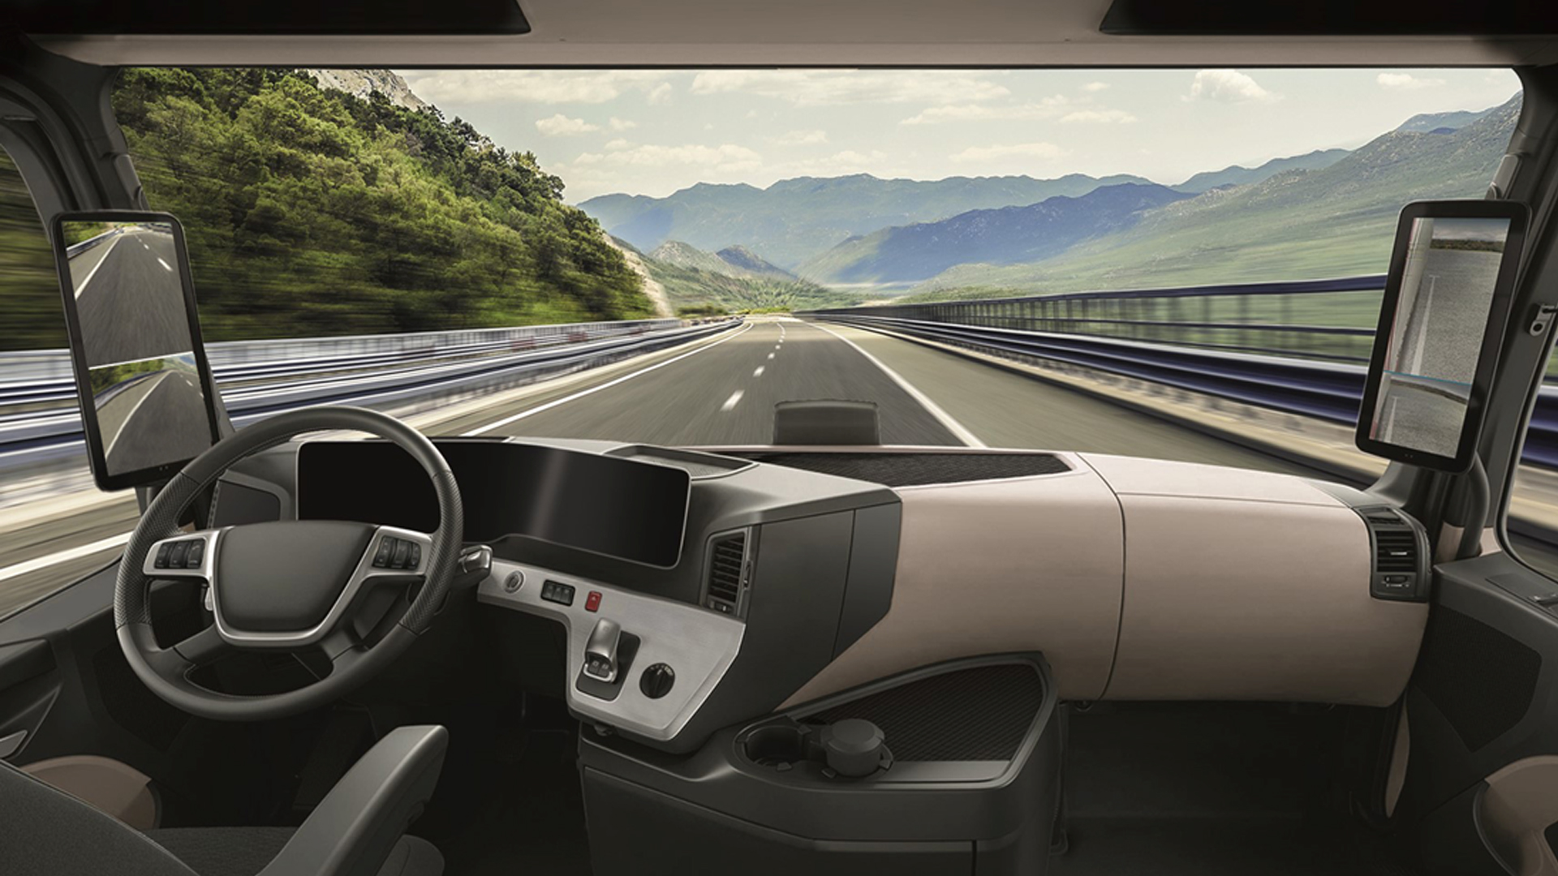
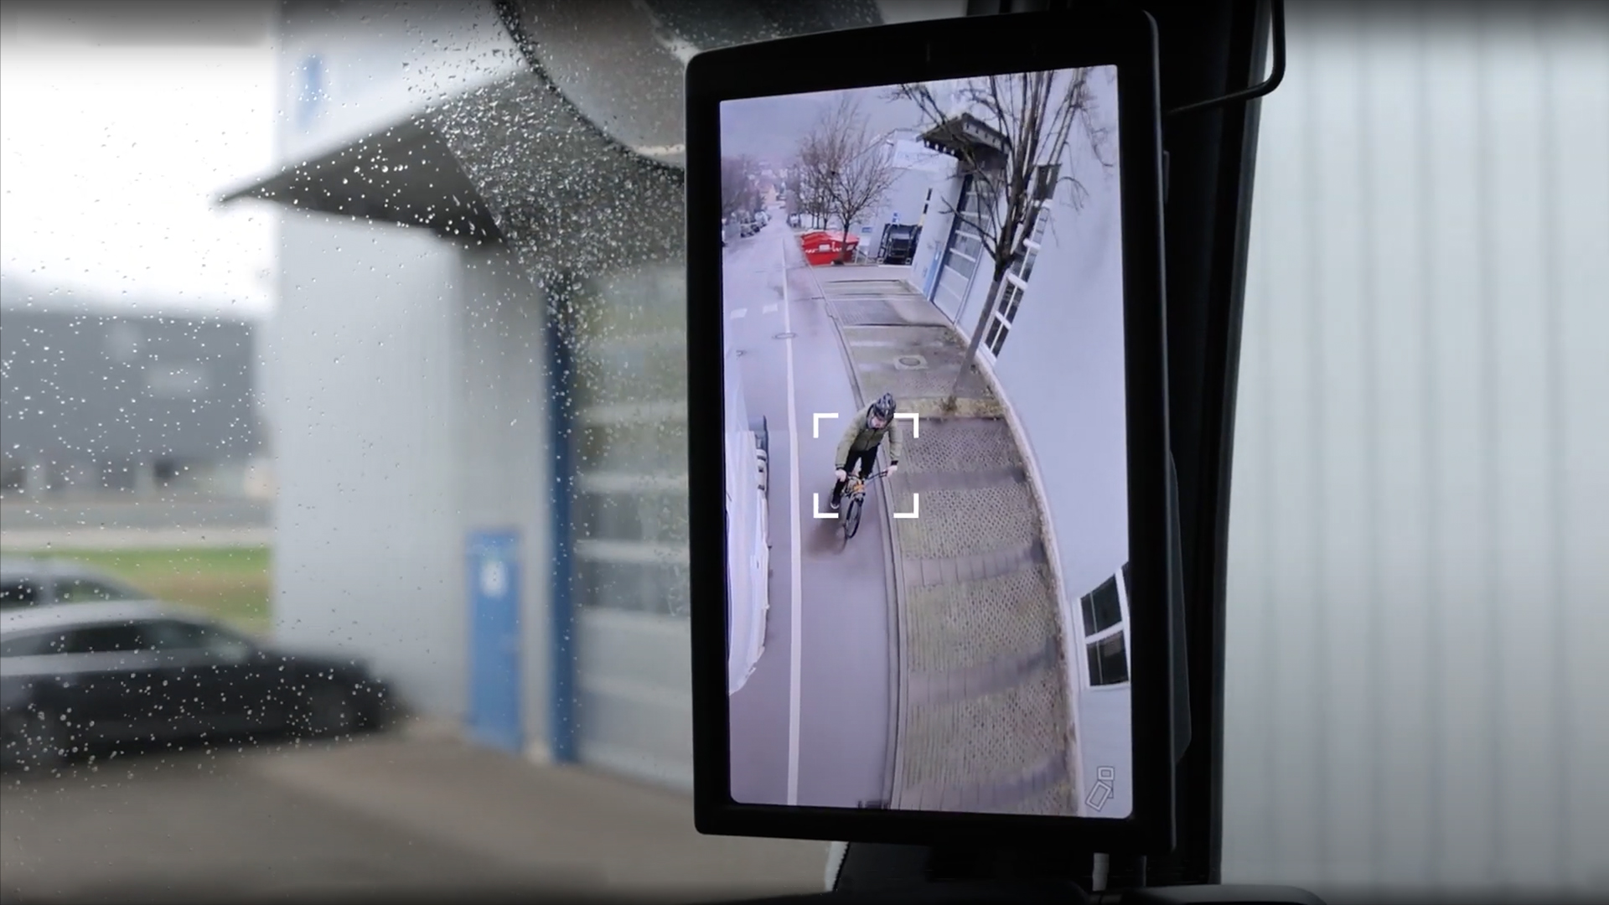
CMS Family - Commercial Vehicles
Segment: Digital vision systems / CMS [commercial vehicles]
Category: Product
Description
Different regions/customers/needs require flexible and cost-efficient solutions. Motherson's CMS product family for commercial vehicles enables customers to focus on their competitive specifics. Products ranging from standard CMS [3in1 mirror replacement] to high level CMS incl ADAS features.
Main advantages
Cost reduction
Providing “design to cost” ready to go solutions meet customer needs
Sustainability
Reduction of air drag result in reduction of fuel take [1%] Reduction of CO2 emission [~3%]
Size reduction
Up to 80% smaller exterior components with significant better direct view
Enhanced experience
Motherson global mirror design and production expertise
System integration
Typology meets cross vehicle integration requirements.
Source: Motherson
Key facts
Applications / Compliance
• Modular & Flexible CMS Product Portfolio
• Best in class image quality in all conditions: Bright day & dark night, rain, snow
• Multiple products
• Different cost levels (entry – high)
• Costumer design language is fully supported
• Support of ADAS (STA, PLCA, BSD)
Global & regional homologation Customer certification All components verified and validated by Motherson
Intellectual property
No IP restrictions worldwide except USA
Idea / feasibility study
(TRL 1-3)
Advanced development
(TRL 4-6)
Serial development
(TRL 7-9)
In production
(SOP)
Source: Motherson
Source: Motherson
1
2
3
4
Contact: Maximilian Kauffmann Function: Global Business Development
Division: Vision Systems Company: SMR
Maximilian.Kauffmann@motherson.com Last modified: 14-04-2023

